Slide 1
Machine Learning
AIML CZG565
M3 : Linear Models for Regression
Neha Vinayak
Course Faculty of MTech Cluster
BITS – CSIS - WILP

Slide 2

Machine Learning
Disclaimer and Acknowledgement
The content for these slides has been obtained from books and various other source on the Internet
We here by acknowledge all the contributors for their material and inputs.
We have provided source information wherever necessary
Students are requested to refer to the textbook w.r.t detailed content of the presentation deck shared over canvas
We have reduced the slides from canvas and modified the content flow to suit the requirements of the course and for ease of class presentation
Source: “Probabilistic Machine Learning, An Introduction”, Kevin P. Murphy, Slides of Prof.Sugata, Prof. Chetana from BITS Pilani, Prof. Raja vadhana from BITS Pilani , CS109 and CS229 stanford lecture notes and many others who made their course materials freely available online.

Slide 3
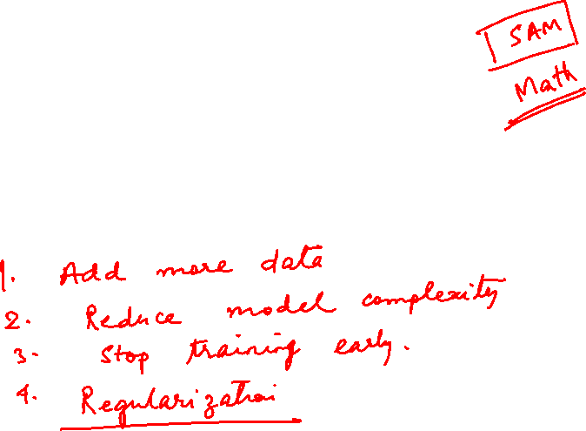
Regularization
(*This notion is common for both Linear Regression – Module 3 and Logistic Regression – Module 4)

Slide 4
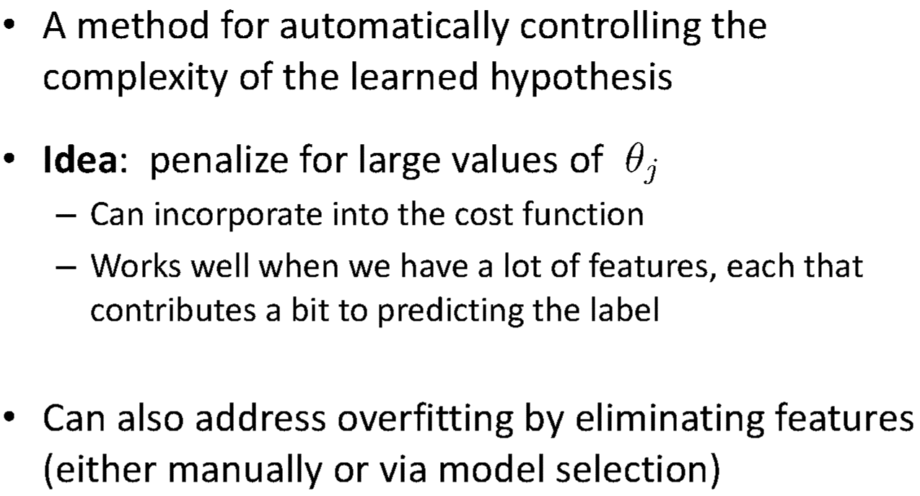
Regularization

Slide 5
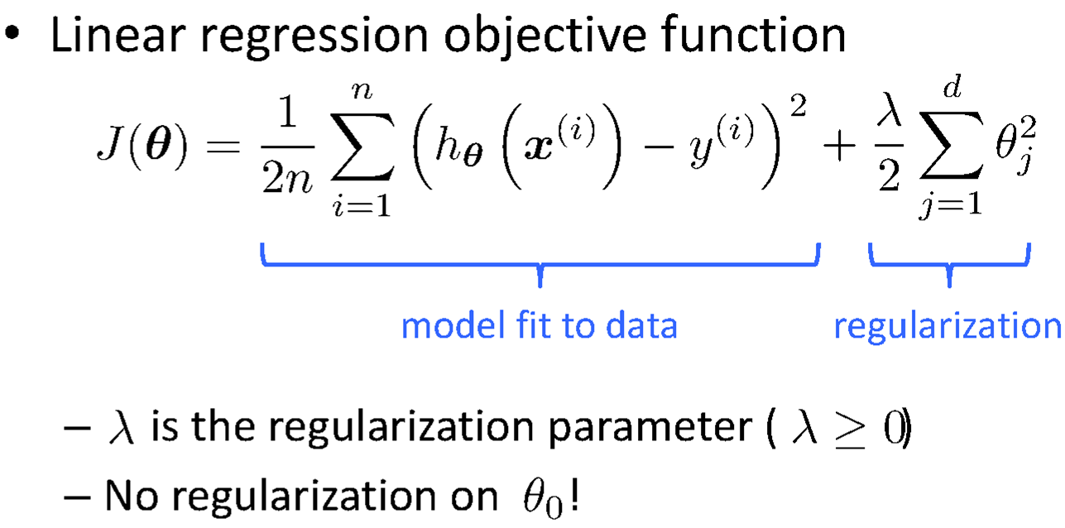
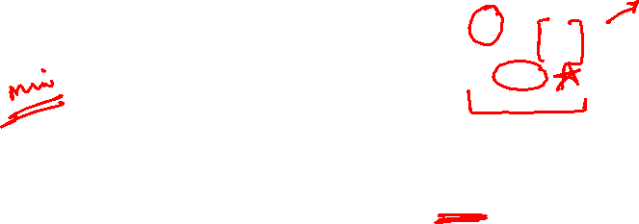
Regularization

Slide 6
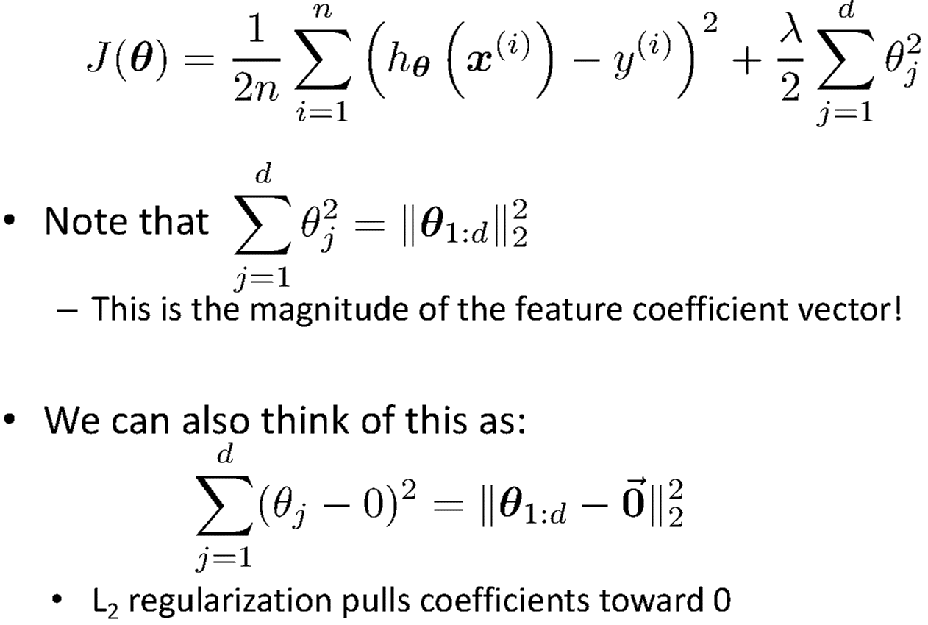
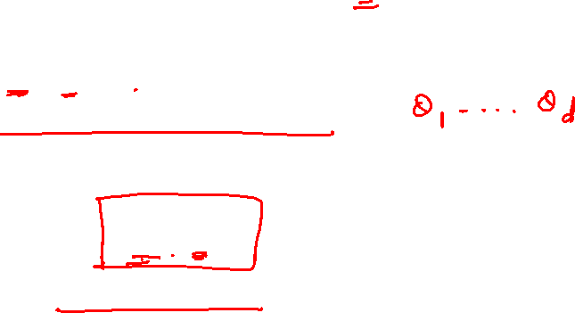
Understanding Regularization

Slide 7
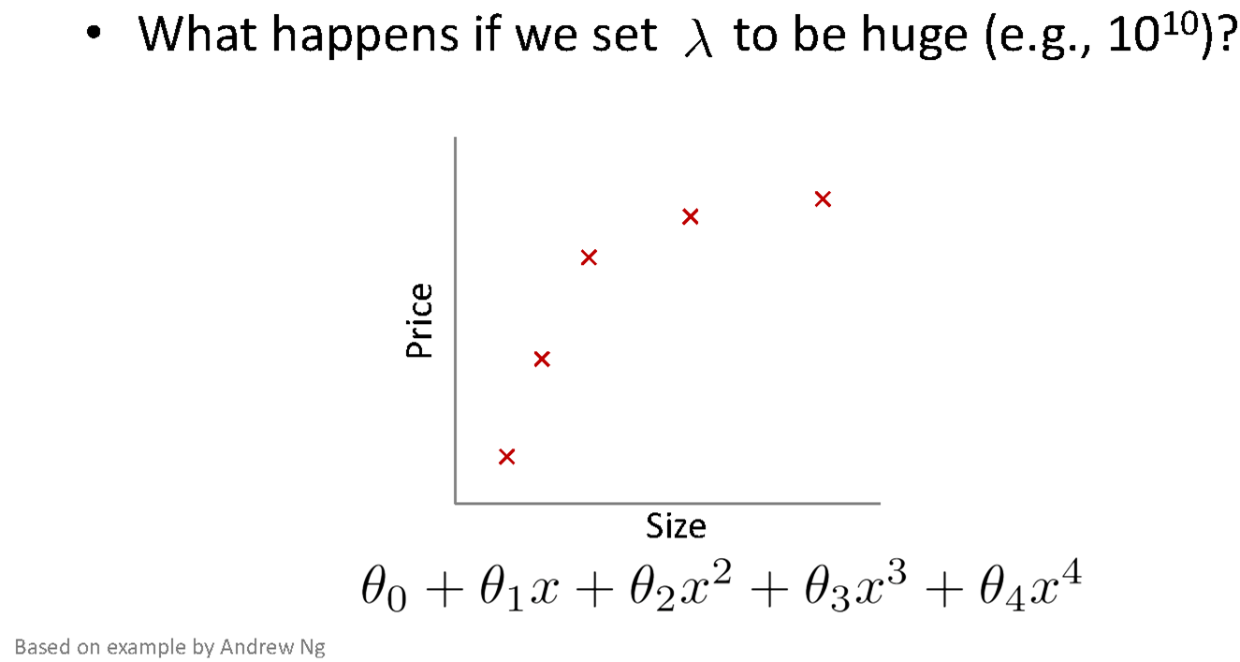
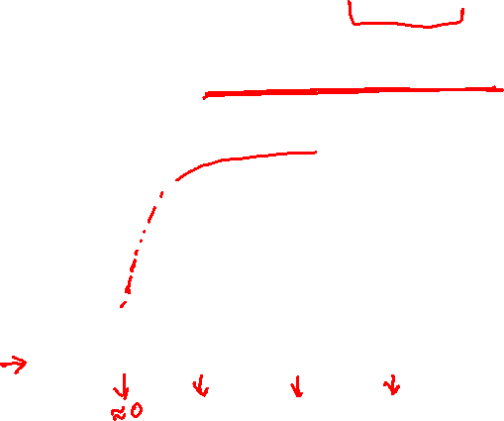
Understanding Regularization

Slide 8
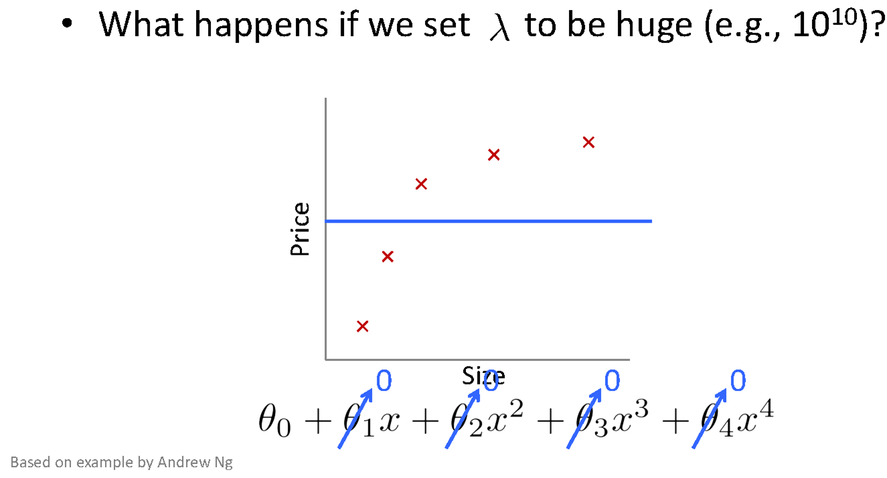

Understanding Regularization

Slide 9
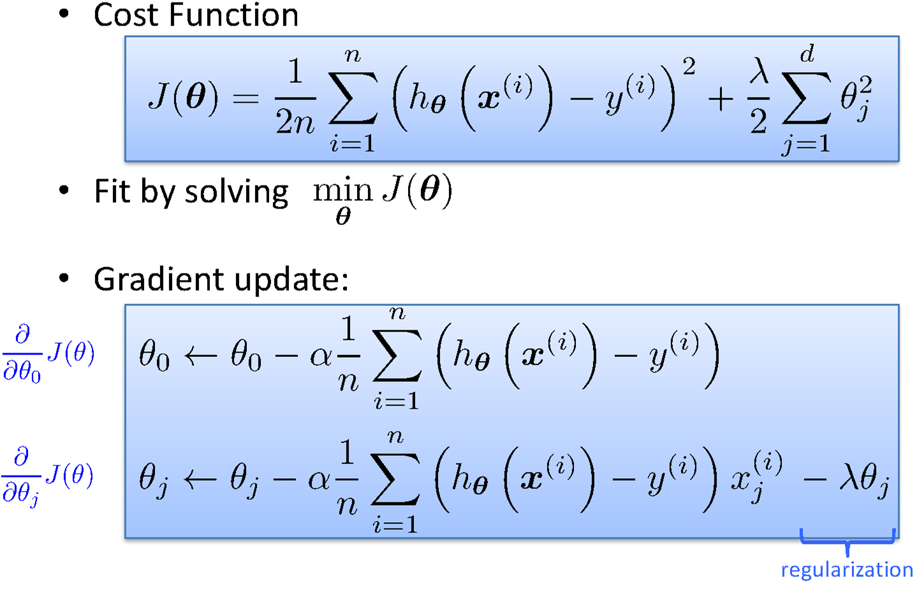
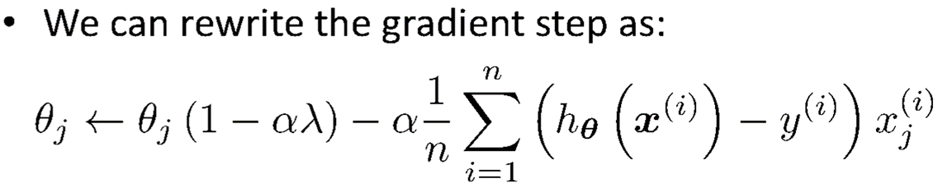
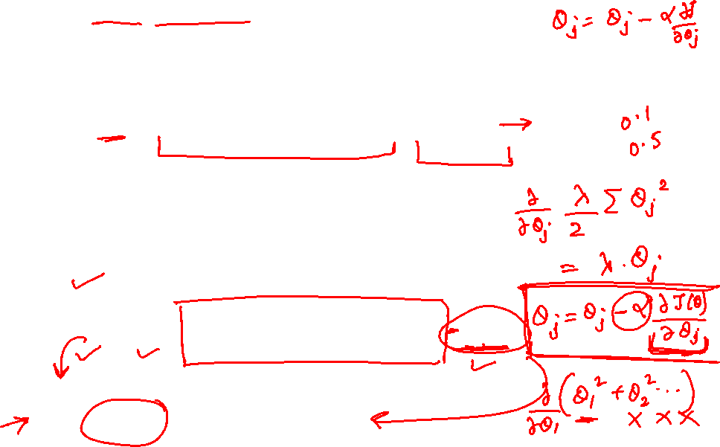
Regularization
Ridge Regression / Tikhonov regularization

Slide 10
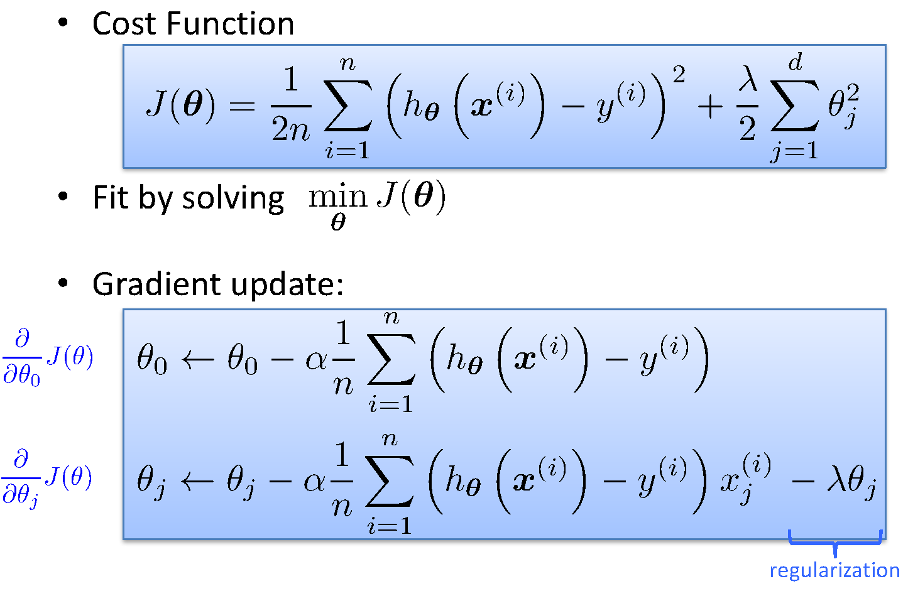
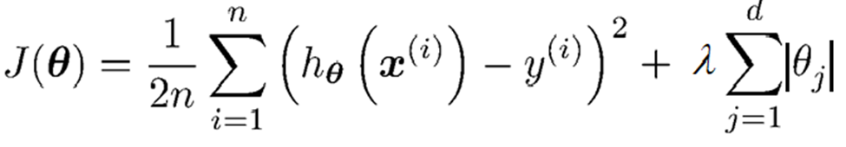
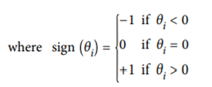
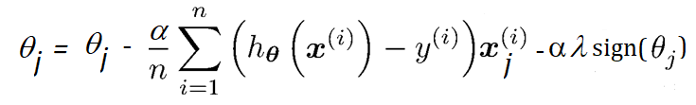
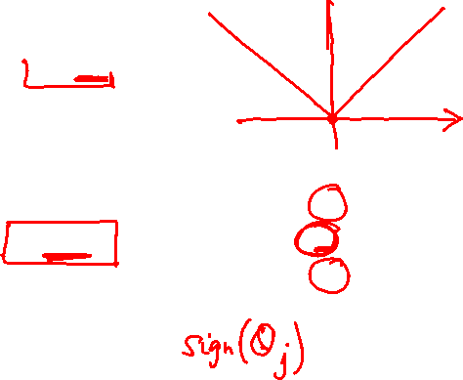
Regularization
Lasso Regression (Least Absolute Shrinkage and Selection Operator Regression)

Slide 11
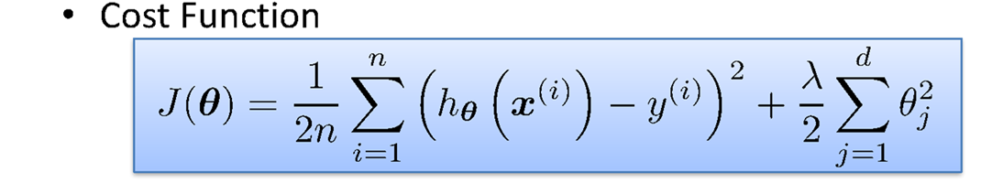
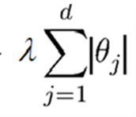


Regularization
Elastic Net
+ r
Control the regularization using the Mix Ratio “r”:
When,
r = 0, Elastic Net is equivalent to Lasso Regression,
r = 1, it is equivalent to Ridge Regression
from sklearn.linear_model import ElasticNet
ElasticNet(alpha=0.1, l1_ratio=0.5)

Slide 12
How to choose the right Regularization?
Common Usage & Observation
L1 regularization has the ability to set some coefficients to 0 exactly leading to a sparse model
L1 regularization helps in feature selection by eliminating the features that are not important
L1 cannot be used efficiently in gradient-based approaches since it is not-differentiable unlike L2
L2 will in general lead to small magnitudes of weights but not exactly 0.
Elastic net – Prefer in Highly correlated features

Slide 13
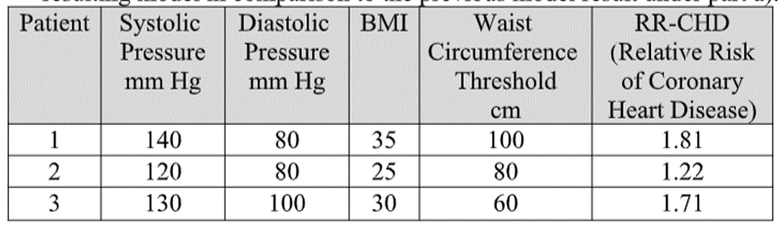
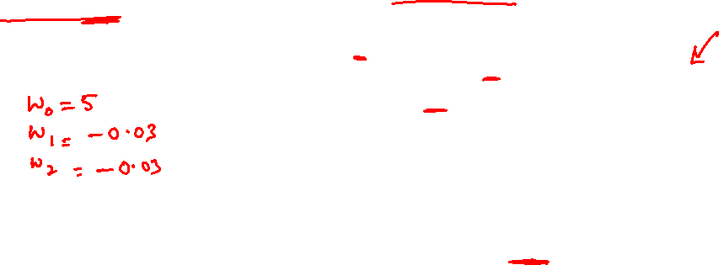
Numerical Exercise – For Student Practice
Fit a linear regression. Show only the first iteration of Gradient descent algorithm using learning rate of 0.02 for the following data , if the Relative Risk of Coronary Heart Disease is believed to be only linearly dependent on BMI as well as Diastolic Pressure. Assume the intercept of the regression model as 5 and the slope of independent variables as -0.03 (negative).
Apply a regularization on the same problem with regularization constant 5 and apply GD for 2 iterations & interpret the results. Try both ridge regression as well as lasso regression. Below equation is changed only for ridge regression. Students must apply appropriate GD update equation changes for this problem.
Steps :
Identification of the equations
Cost function & derivative
Apply the equations

Slide 14
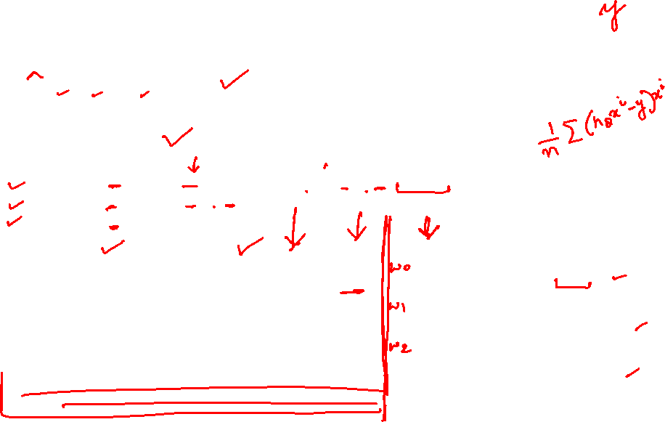
Numerical Exercise – For Student Practice
Solved Without Regularization
Steps :
Identification of the equations
y = w0+w1X1+w2X2
Cost function & derivative
a. Compute Error
error=y^​−y
b. Compute Gradients
∂J​/∂w0 = 1/3 * (sum (error))
∂J​/∂w1 = 1/3 * (sum [error * x1])
∂J​/∂w2 = 1/3 * (sum [error * x2])
c. Update Weights
wj​ = wj’ – α * ​∂J​/ ∂wj
Patient | Y | Ŷ | Error | Gradients | Updated Weights
1 | 1.81 | (5 - 0.03(35) - 0.03(80)) = 1.55 | -0.26 | -0.08 | w0 ​ = 5−0.02(−0.08) = 5.0016​
2 | 1.22 | (5 - 0.03(25) - 0.03(80)) = 1.85 | 0.63 | -3.8833 | w1​ = −0.03−0.02(−3.8833) = 0.0477​
3 | 1.71 | (5 - 0.03(30) - 0.03(100)) = 1.10 | -0.61 | -10.4667 | w2​ = −0.03−0.02(−10.4667) = 0.1793​

Slide 15
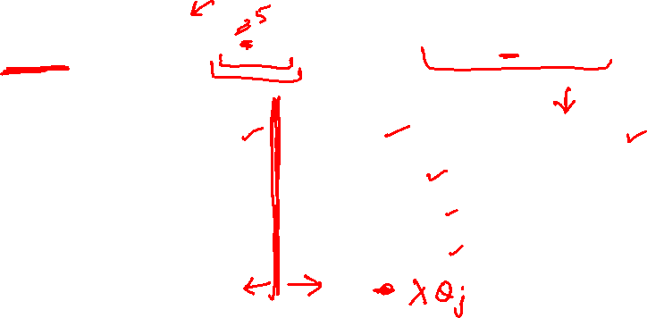
Numerical Exercise – For Student Practice
Solved With Ridge Regularization
Steps :
Identification of the equations
y = w0+w1X1+w2X2
Cost function & derivative
a. Compute Error
error=y^​−y
b. Compute Gradients
∂J/ ∂wj ​=1/n * ​∑(error * xj​)+λ/n * ​wj ​,j≥1
c. Update Weights
wj​’ = wj – α * ​∂J​/ ∂wj
Patient | Y | Ŷ | Error | Gradients | Updated Weights
1 | 1.81 | 1.55 | -0.26 | (∂J/∂w_0 = -0.08) | (w_0' = 5.0016)
2 | 1.22 | 1.85 | 0.63 | (∂J/∂w_1 = -3.9333) | (w_1' = 0.0487)
3 | 1.71 | 1.10 | -0.61 | (∂J/∂w_2 = -10.5167) | (w_2' = 0.1803)

Slide 16
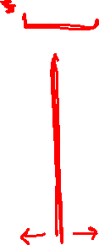
Numerical Exercise – For Student Practice
Solved With Lasso Regularization
Steps :
Identification of the equations
y = w0+w1X1+w2X2
Cost function & derivative
a. Compute Error
error=y^​−y
b. Compute Gradients
∂J/ ∂wj ​=1/n * ​∑(error * xj​)+λ/n * ​sign(wj) ​,j≥1
c. Update Weights
wj​’ = wj – α * ​∂J​/ ∂wj
Patient | Y | Ŷ | Error | Gradients | Updated Weights
1 | 1.81 | 1.55 | -0.26 | (∂J/∂w_0 = -0.08) | (w_0' = 5.0016)
2 | 1.22 | 1.85 | 0.63 | (∂J/∂w_1 = -5.55) | (w_1' = 0.0810)
3 | 1.71 | 1.10 | -0.61 | (∂J/∂w_2 = -12.1333) | (w_2' = 0.2127)

Slide 17
Python Lab Exercise – For Student Practice
Go to your virtual lab file under : Machine Learning 🡪 LabCapsule 2 Linear _ Polynomial Regression 🡪 3 Polynomial Regression
Download ML_Lab 5 PolynomialRegression.ipynb
Try to change the degree to {2, 5, 7, 10} in the below function line :
PolynomialFeatures(degree=3)
Observe and interpret on the performance of the training data
Note: Training vs Test Data split is not coded in this implementation. Below are the suggestions to experiment further:
Add few hundreds of data (Use synthetic data generation python libraries available : Refer here )
Split the data into 80% train vs 20% test set
Built the polynomial model using above four different degree on training set
For each of the model apply in the test set
Find the MSE for both training data and separately for test data
Plot the four experiment results in a plot and interpret the notion of overfit vs underfit
Suggest which degree is a best fit .

Slide 18
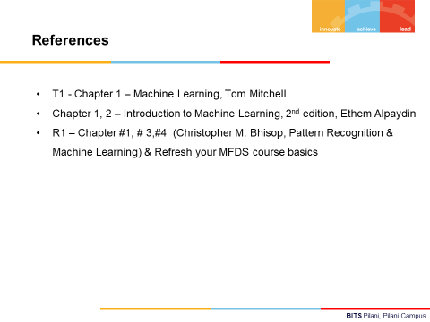

Slide 19
Thank you !

